Slide 1
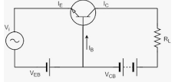
TRANSISTOR AS AN AMPLIFIER L1
A transistor acts as an amplifier by raising the strength of a weak signal. The DC bias voltage applied to the emitter base junction, makes it remain in forward biased condition. ... Thus a small input voltage results in a large output voltage, which shows that the transistor works as an amplifier.

Slide 2
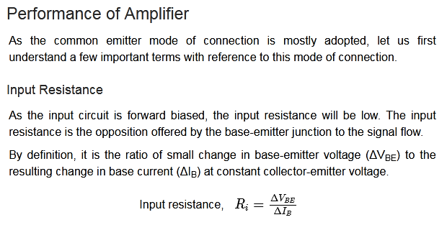

Slide 3
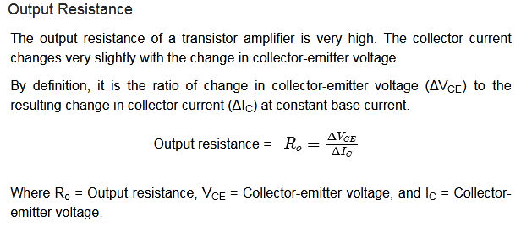

Slide 4
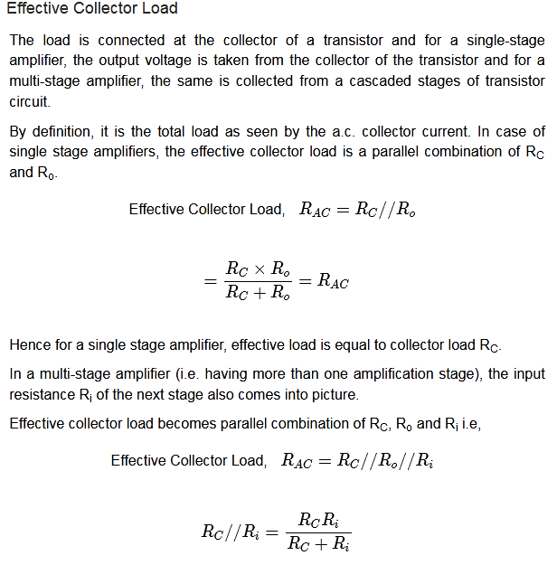

Slide 5
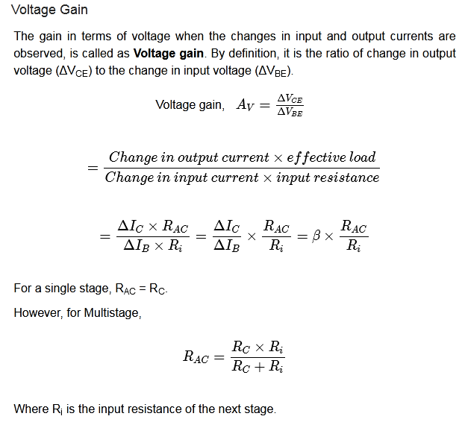

Slide 6
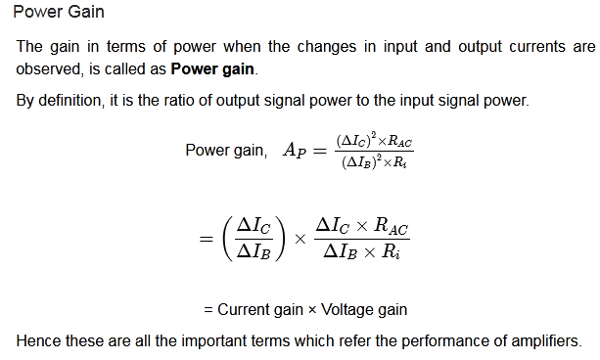

Slide 7
Amplifier Classes
Amplifiers are classified into classes according to their construction and operating characteristics.

Slide 8
Based on the input signals
Depending upon the magnitude of the input signal applied, they can be categorized as Small signal and large signal amplifiers.
Small signal Amplifiers − When the input signal is so weak so as to produce small fluctuations in the collector current compared to its quiescent value, the amplifier is known as Small signal amplifier.
Large signal amplifiers − When the fluctuations in collector current are large i.e. beyond the linear portion of the characteristics, the amplifier is known as large signal amplifier.
Based on its output signals
Depending upon the parameter that is amplified at the output, there are voltage and power amplifiers.
Voltage Amplifiers − The amplifier circuit that increases the voltage level of the input signal, is called as Voltage amplifier.
Power Amplifiers − The amplifier circuit that increases the power level of the input signal, is called as Power amplifier

Slide 9
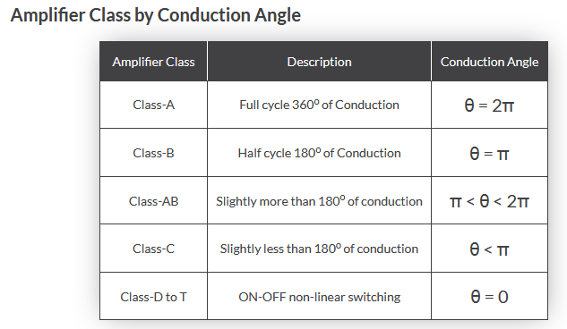

Slide 10
Based on number of stages
Depending upon the number of stages of Amplification, there are Single-stage amplifiers and Multi-stage amplifiers.
Single-stage Amplifiers − This has only one transistor circuit, which is a single stage amplification.
Multi-stage Amplifiers − This has multiple transistor circuit, which provides multi-stage amplification.
Based on the frequency range
Depending upon the frequency range of the signals being used, there are audio and radio amplifiers.
Audio Amplifiers − The amplifier circuit that amplifies the signals that lie in the audio frequency range i.e. from 20Hz to 20 KHz frequency range, is called as audio amplifier.
Power Amplifiers − The amplifier circuit that amplifies the signals that lie in a very high frequency range, is called as Power amplifier.

Slide 11
Based on the Coupling method
Depending upon the method of coupling one stage to the other, there are RC coupled, Transformer coupled and direct coupled amplifier.
RC Coupled amplifier − A Multi-stage amplifier circuit that is coupled to the next stage using resistor and capacitor (RC) combination can be called as a RC coupled amplifier.
Transformer Coupled amplifier − A Multi-stage amplifier circuit that is coupled to the next stage, with the help of a transformer, can be called as a Transformer coupled amplifier.

Slide 12
Single Stage(small signal)Transistor Amplifiers
single stage transistor amplifier(Small signal amplifier)
By a stage we mean a single transistor with its bias and auxiliary
equipment. It may be emphasised here that a
practical amplifier is always a multistage amplifier
i.e. it has a number of stages of amplification.
However, it is profitable to consider the multistage
amplifier in terms of single stages that are connected together. In this chapter, we shall confine our attention to
single stage transistor amplifiers.
In Another word

Slide 13
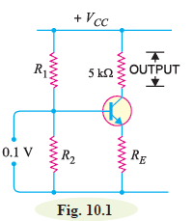
Single Stage Transistor Amplifier
When only one transistor with associated circuitry is used for
amplifying a weak signal, the circuit is known as single stage
transistor amplifier. A single stage transistor amplifier has one
transistor, bias circuit and other auxiliary components. Although
a practical amplifier consists of a number of stages, yet such a
complex circuit can be conveniently split up into separate single
stage by analysing carefully only a single stage and using this single
stage analysis repeatedly, we can effectively analyse the complex circuit. It follows, therefore, that single stage amplifier analysis is of great value in understanding the
practical amplifier circuits.

Slide 14
How single stage transistor amplifier works?
Fig. 10.1 shows a single stage transistor amplifier. When a weak a.c. signal is given to the base of transistor, a small base current (which is a.c.) starts flowing. Due to transistor action, a much larger (β X ib = Ic) a.c. current flows through the collector load RC. As the value of RC is quite
high (usually 4-10 kΩ), therefore, a large voltage appears across RC. Thus, a weak signal applied in the base circuit appears in amplified form in the collector circuit. It is in this way that a transistor acts as an amplifier. The action of transistor amplifier can be beautifully explained by referring to Fig. 10.1. Suppose a change of 0.1V in signal voltage produces a change of 2 mA in the collector current. Obviously, a signal of only 0.1V applied to the base will give an output voltage
= 2 mA × 5 kΩ = 10V. Thus, the transistor has been able to raise the voltage level of the signal from 0.1V to 10V i.e. voltage amplification or stage gain is 100.

Slide 15
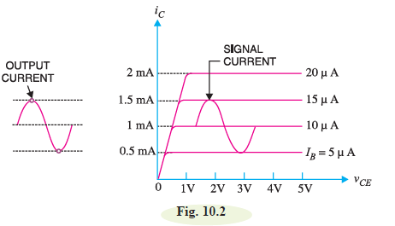
Graphical Demonstration of Transistor Amplifier

Slide 16
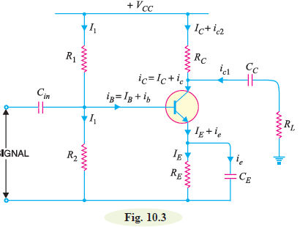
Practical Circuit of Transistor Amplifier
It is important to note that a transistor can accomplish faithful amplification only if proper associated circuitry is used with it. Fig. 10.3 shows a practical single stage transistor amplifier. The various circuit elements and their functions are described below :

Slide 17
(i) Biasing circuit. The resistances R1, R2 and RE form the biasing and stabilization circuit.
The biasing circuit must establish a proper operating point otherwise a part of the negative half-cycle of the signal may be cut off in the output.
(ii) Input capacitor Cin. An electrolytic capacitor Cin
(=10 μF ) is used to couple the signal to the base of the transistor. If it is not used, the signal source resistance will come across R2 and thus change the bias. The capacitor Cin allows only a.c. signal to flow but isolates the signal source from R2.*
iii) Emitter bypass capacitor CE. An emitter bypass capacitor CE (=100μF ) is used in parallel with RE to provide a low reactance path to the amplified a.c. signal. If it is not used, then amplified a.c. signal flowing through RE will cause a voltage drop across it, thereby reducing the output voltage.

Slide 18
(iv) Coupling capacitor CC. The coupling capacitor CC (=10μF) couples one stage of amplification to the next stage.
*It may be noted that a capacitor offers infinite reactance to d.c. and blocks it completely whereas it allows a.c. to pass through it*.
If it is not used, the bias conditions of the next stage will be drastically changed due to the shunting effect of RC. This is because RC will come in parallel with the upper resistance R1 of the biasing network of the next stage, thereby altering the biasing conditions of the latter. In short, the coupling capacitor CC isolates the d.c. of one stage from the next stage, but allows the passage of a.c. signal.

Slide 19
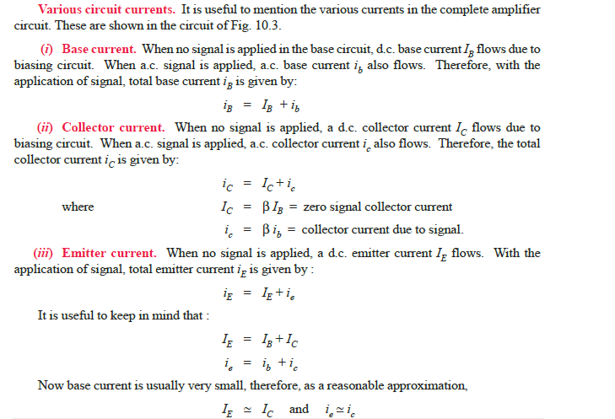

Slide 20
Phase Reversal
In common emitter connection, when the input signal voltage increases in the positive sense, the output voltage increases in the negative direction and vice-versa. In other words, there is a phase difference of 180° between the input and output voltage in CE connection. This is called phase reversal.*
The phase difference of 180° between the signal voltage and output voltage in a common emitter
amplifier is known as phase reversal.
Consider a common emitter amplifier circuit shown in
Fig. 10.5. The signal is fed at the input terminals (i.e. between base and emitter) and output is taken from collector and emitter end of supply.
The total instantaneous output voltage vCE is given by :

Slide 21
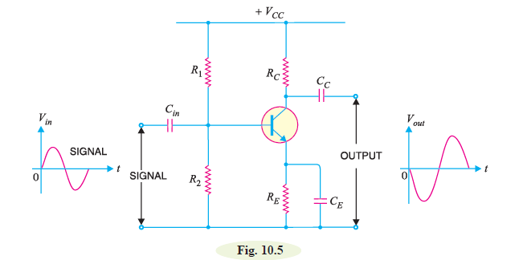

When the signal voltage increases in the positive half-cycle, the base current also increases. The result is that collector current and hence voltage drop iC RC increases. As VCC is constant, therefore, output voltage vCE decreases. In other words, as the signal voltage is increasing in the positive half cycle, the output voltage is increasing in the negative sense i.e. output is 180° out of phase with the input. It follows, therefore, that in a common emitter amplifier, the positive half-cycle of the signal appears as amplified negative half-cycle in the output and vice-versa. It may be noted that amplification is not affected by this phase reversal.
The fact of phase reversal can be readily proved mathematically. Thus differentiating exp. (i),we get,
The negative sign shows that output
voltage is 180° out of phase with
the input signal voltage.

Slide 22
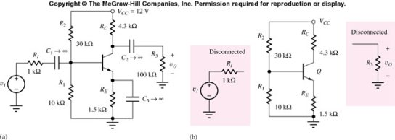
D C Equivalent for the BJT Amplifier
DC Equivalent Circuit
All capacitors in the original amplifier circuit are replaced by open circuits, disconnecting v_{I}, R_{I}, and R₃ from the circuit and leaving R_{E} intact. The the transistor Q will be replaced by its DC model.

Slide 23
A.C. equivalent circuit.
In the a.c. equivalent circuit of a transistor amplifier, only a.c. conditions are to be considered. Obviously, the d.c. voltage is not important for such a circuit and may be considered zero. The capacitors are generally used to couple or bypass the a.c. signal. The designer intentionally selects capacitors that are large enough to appear as short circuits to the a.c. signal. in order to draw the a.c. equivalent circuit, the following two steps are applied to the transistor circuit :
(a) Reduce all d.c. sources to zero (i.e. VCC = 0).
(b) Short all the capacitors.

Slide 24
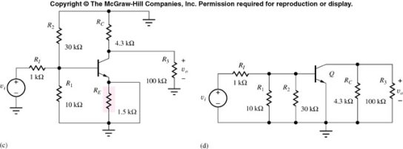
A C Equivalent for the BJT Amplifier
R₁IIR₂=R_{B}
R_{o}
R_{in}
Coupling capacitor C_{C} and Emitter bypass capacitor C_{E} are replaced by short circuits.
DC voltage supply is replaced with short circuits, which in this case is connected to ground.

Slide 25
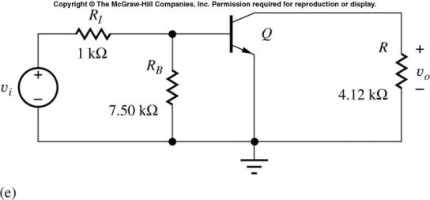
A C Equivalent for the BJT Amplifier (continued)
All externally connected capacitors are assumed as short circuited elements for ac signal
circuit above is constructed. Here, the transistor will be replaced by its
equivalent small-signal AC model (to be developed).
By combining parallel resistors into equivalent R_{B} and R, the equivalent AC

Slide 26
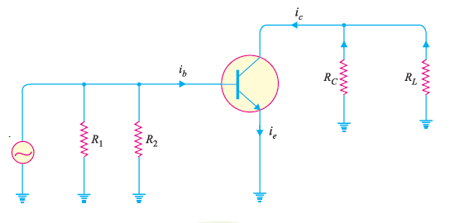
It may be seen that total current in any branch is the sum of d.c. and a.c. currents through that branch. Similarly, the total voltage across any branch is the sum of d.c. and a.c. voltages across that branch.

Slide 27
Role of Capacitors in Transistor Amplifiers
Regardless of the manner in which a capacitor is connected in a transistor amplifier, its behaviour towards d.c. and a.c. is as follows. A capacitor blocks d.c. i.e. a capacitor behaves as an “open**” to d.c. Therefore, for d.c. analysis, we can remove the capacitors from the transistor amplifier circuit.
A capacitor offers reactance (= 1/2πfC) to a.c. depending upon the values of f and C. In practical transistor circuits, the size of capacitors is so selected that they offer negligible (ideally zero) reactance to the range of frequencies handled by the circuits. Therefore, for a.c. analysis, we can replace
the capacitors by a short i.e. by a wire. The capacitors serve the following two roles in transistor
amplifiers :
1. As coupling capacitors
2. As bypass capacitors

Slide 28
Thus for a.c. purposes, RE does not exist. We have already seen in the previous chapter that CE plays an important role in determining the
voltage gain of the amplifier circuit. If CE is
removed, the voltage gain of the amplifier
is greatly reduced. Note that Cin is the coupling capacitor in this circuit.
Important Terms
In the study of multistage amplifiers, we shall frequently come across the terms gain,
frequency response, decibel gain and bandwidth.

